Slide 1

STOCK
Harun Ćerim
Ilda Balliu
Kaan Yöş
Mahran Emeiri
Stock Prediction and Sentiment Analysis System

Slide 2

One Platform
Company Details and Market History
Possibility to Predict
Company & Stock Market Related Articles
Future Predictions

Slide 3


High Level Diagram
Model Parameters
Request
FRONTEND
BACKEND
Model Results
Model Results
Prediction Algorithms

Slide 4
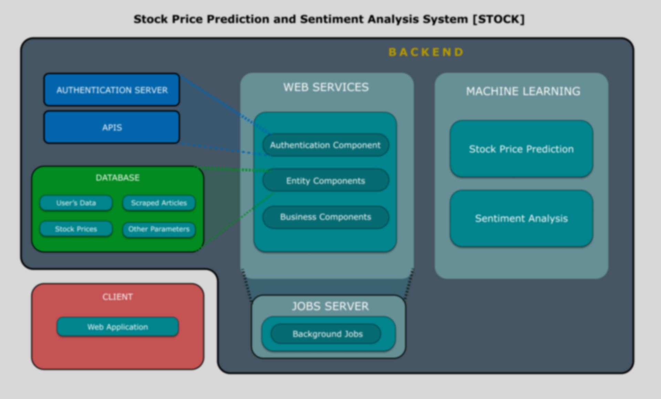


Slide 5








Technical Info

Slide 6

Tools

Slide 7

User Types
Casual User
Individuals who are interested in stock market
Intermediate User
Individuals who have knowledge on stock market.
They have brief information about Machine Learning.
Advanced User
Individuals who know how stock market is working.
Have worked with Machine Learning before and know which model parameters to tweak.

Slide 8
User Types
Academical Purposes

Slide 10
Summary
Let user to choose default predictor for company page
Model export (Pickle)
Hyper Parameter Tuning
Involving articles in prediction (Domain Knowledge and Data Analysis)
Serverless Infrastructure
Future Improvements
Providing information regarding companies and stock market
Sentiment analyzed articles related to stock market
Monitoring favorite companies
Default stock price prediction
User based prediction models

Slide 11

Thank you for your attention

